Slide 1
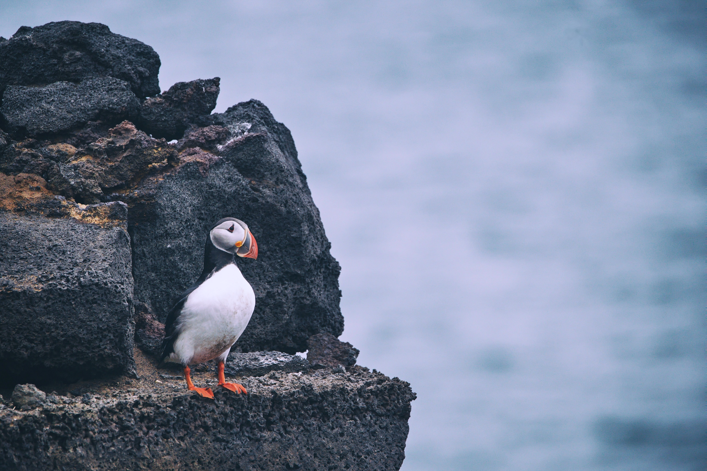
BIRDBOX
Team 25: Team Nirdy
Anthony Hauger
Cora Schneck
Rachel Pabelico
William Harris
Joey Christee
Scott Young
Notes:
Anthony

Slide 2

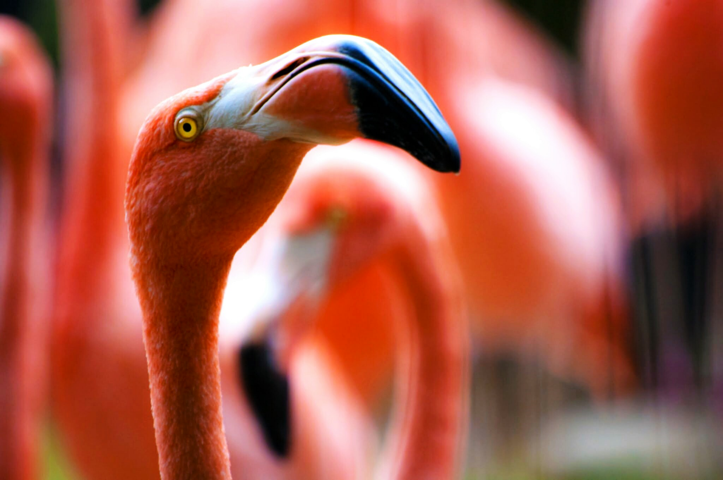
WHAT IS BIRDBOX?
The Appearance Based Interactive Field Guide
AS EASY AS:
1
Size Selection
2
Color Selection
3
Notable Features
Notes:
Scott

Slide 3
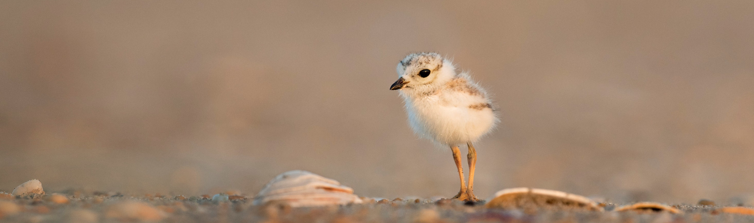

“
”
OUR VISION
To provide competitive user-centered access to avian knowledge
MARKET
$
Students
Scientists
Targeted In-Line Ads
National Parks
Conservatories
Notes:
Joey

Slide 4
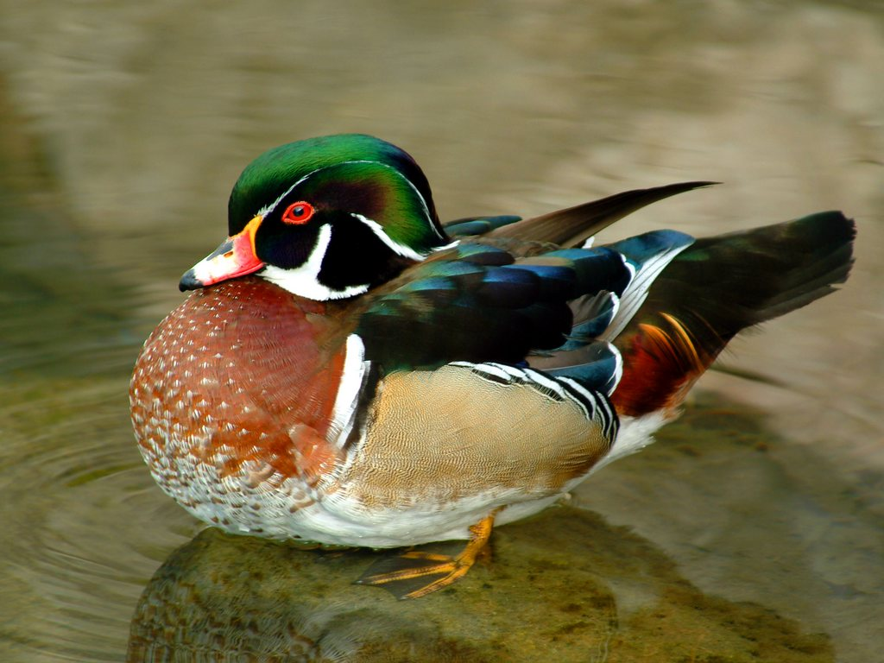
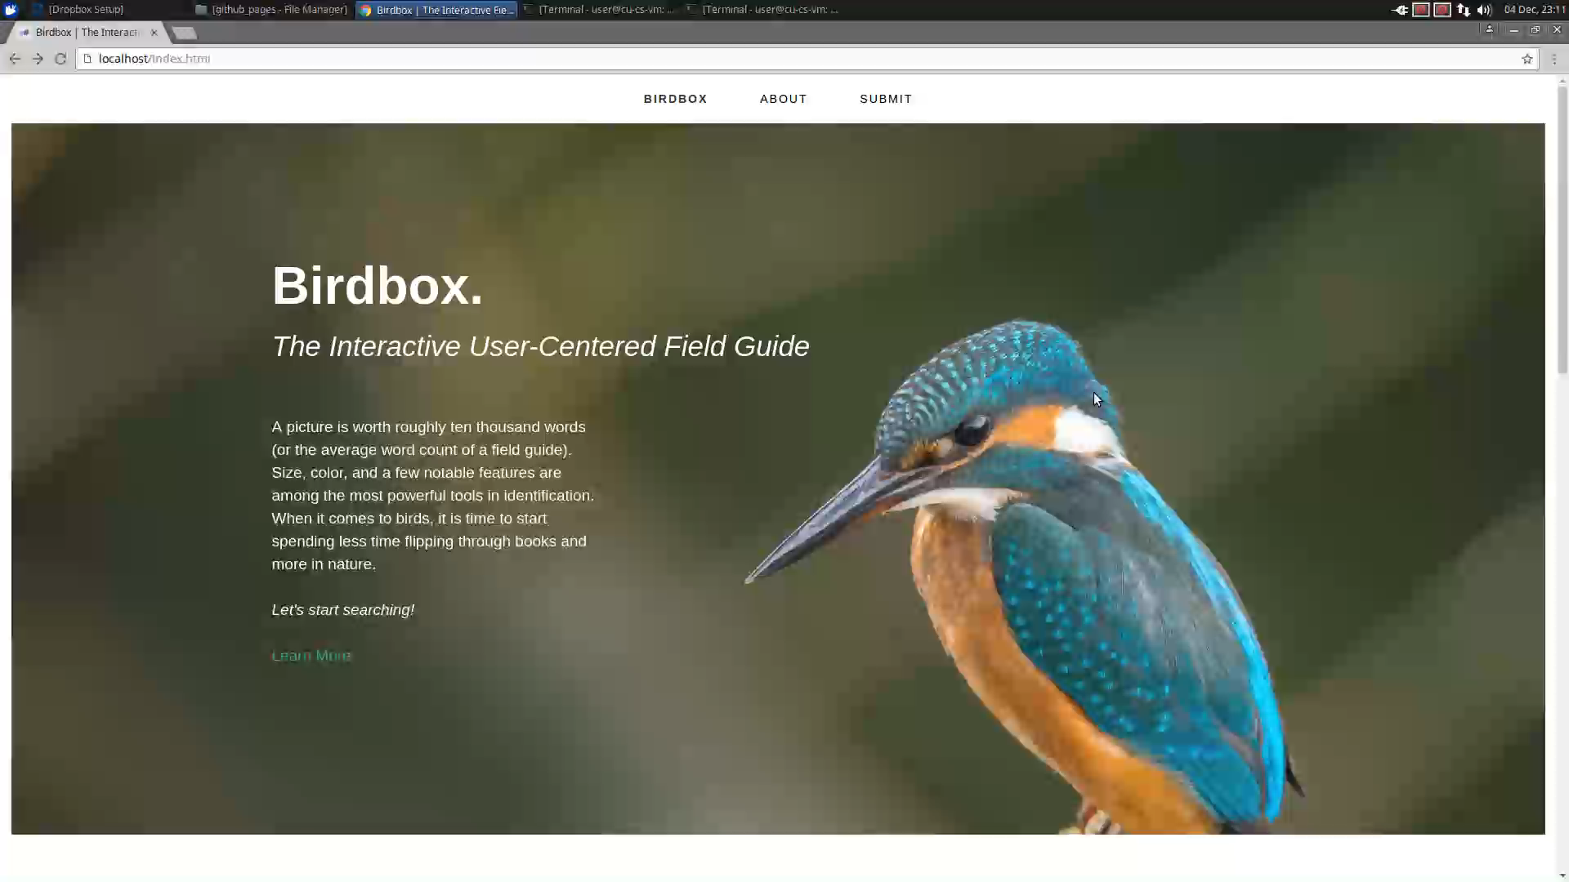
Product Demo
Male Wood Duck
Notes:
Rachel

Slide 5
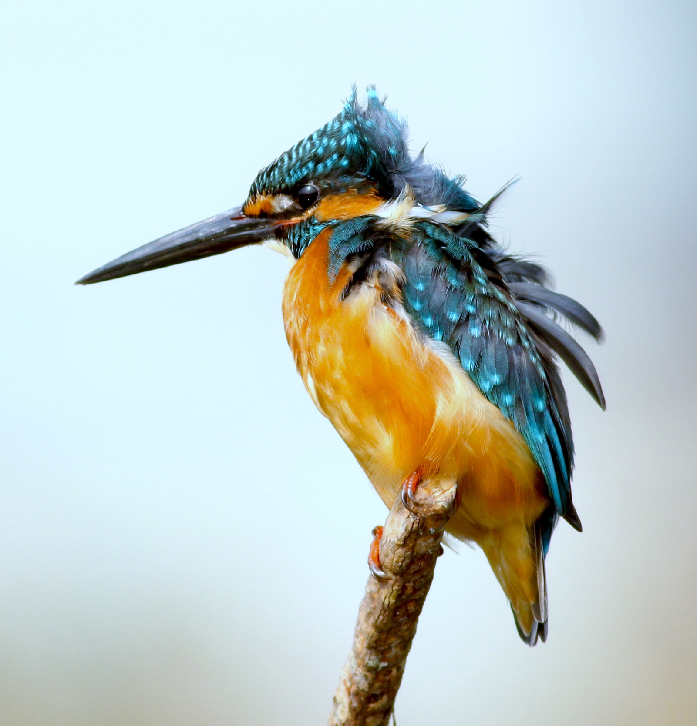
Technical Details
September
Github
HTML Webpage
Populate MySQL
CSS Implementation
PHP
Bootstrap
Automate MySQL
Apache HTTP Server
December
Digital Ocean
Notes:
Cora

Slide 6
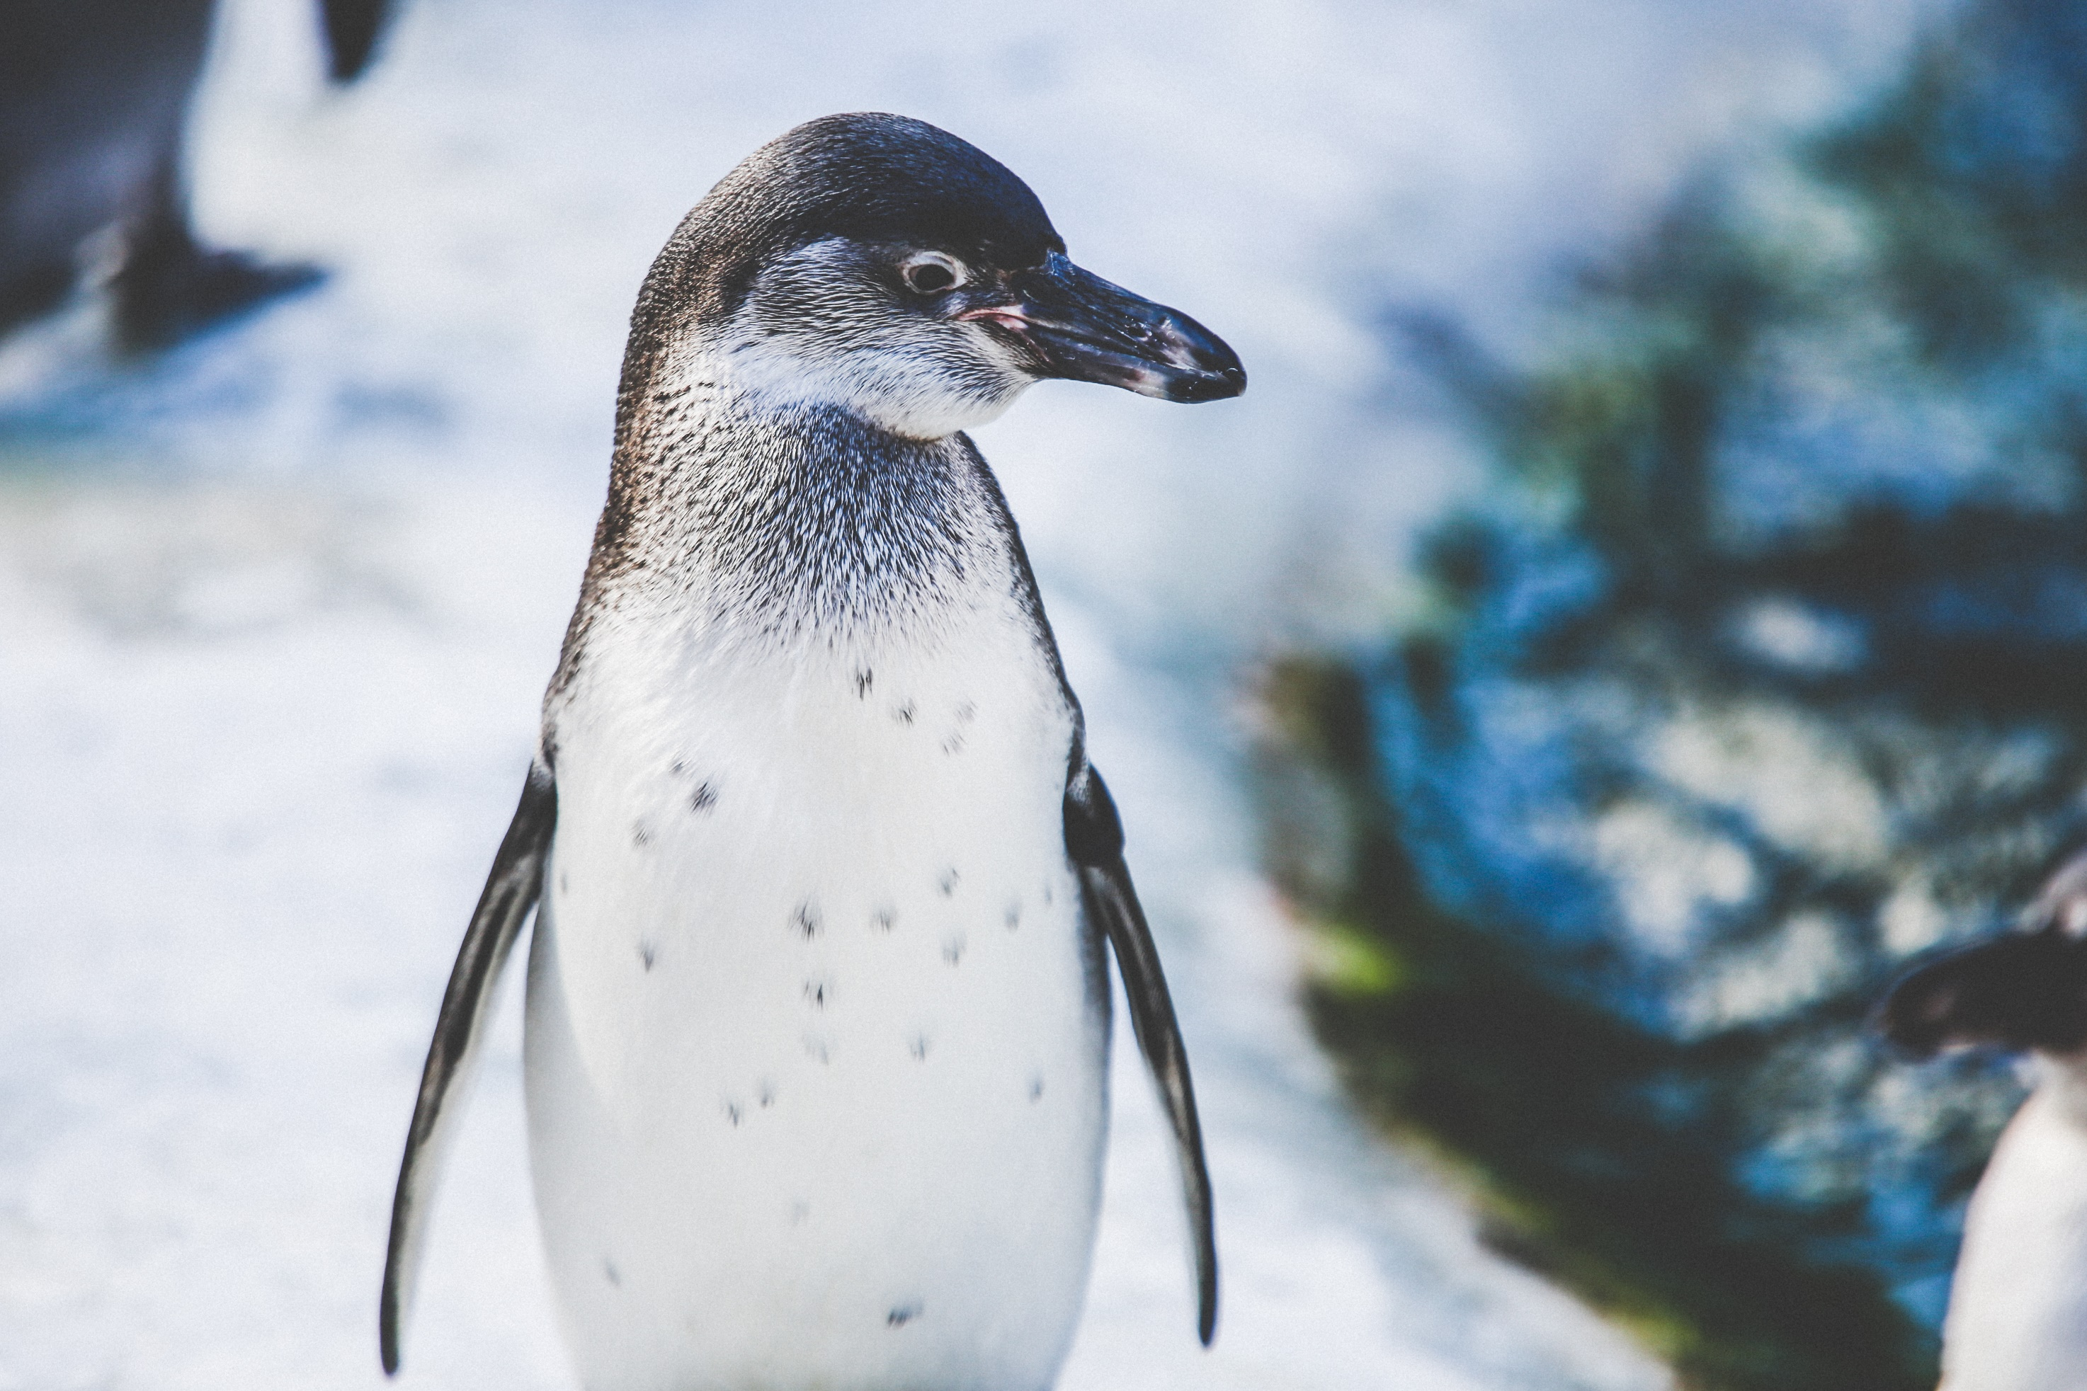
Management and Development
COMMUNICATION
Github
Google Docs
Trello
Slack
DESIGN
Photoshop
Assembly
Notes:
Will

Slide 7

BIRDBOX
Notes:
Will

